Slide 1
Critical Thinking

Slide 2
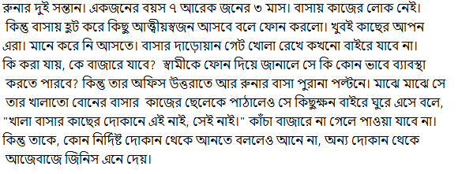

Slide 3

